Slide 1


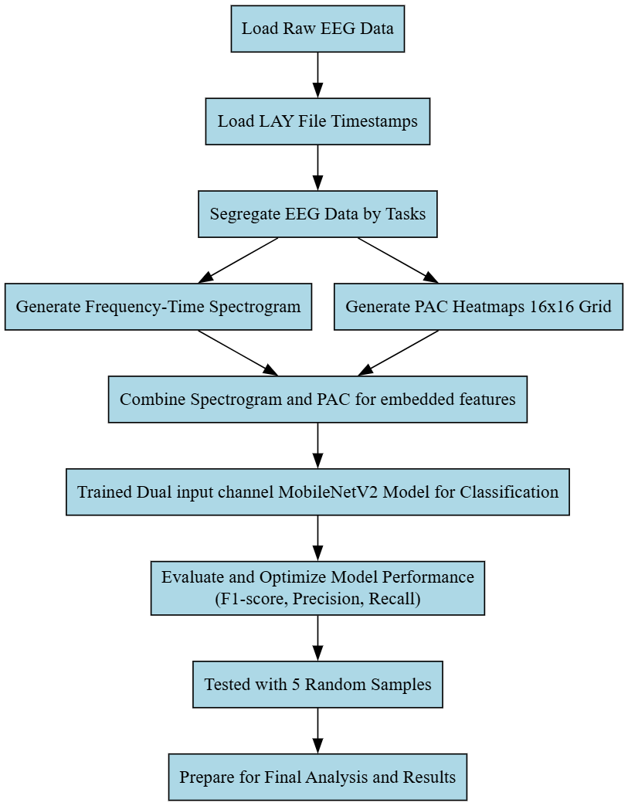
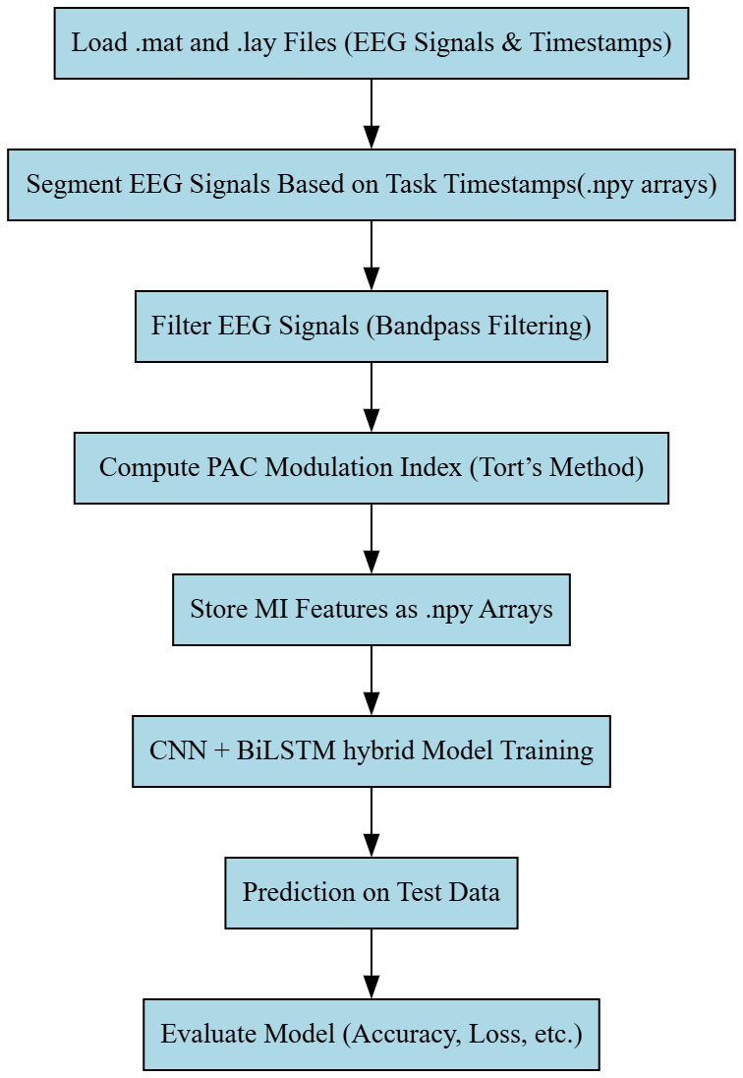
Cognitive Task Classification using EEG signals with Deep Neural Networks
Dharanidharan S I-21BLC1661 Sathya Narayana O R-21BLC1157, Bhuvan D-21BLC1201
Dr.Suchetha M
School of Electronics Engineering
MOTIVATION / INTRODUCTION
Traditional EEG analysis emphasizes frequency bands but not fine enough to distinguish individual cognitive states. Our project refines EEG interpretation by discriminating mental states during various cognitive tasks.
We utilize PAC-based Modulation Index (MI) as a biologically interpretable feature to encode cross-frequency interactions, allowing for more interpretable and more compact representation of cognitive activity across tasks.
Our dataset covers nine cognitive tasks (and baseline), allowing for more comprehensive analysis of executive functions such as memory, attention, and flexibility in 81 subjects—differing from previous research with a narrow task range.
Through proper classification of cognitive states from EEG, this research establishes the foundation for personalized neurorehabilitation approaches to target particular cognitive deficits.
OBJECTIVES
To develop a classification model that accurately identifies cognitive tasks based on EEG signals and PAC-based Modulation Index (MI) features.
To explore and implement advanced feature extraction techniques using Phase-Amplitude Coupling to enhance task-specific EEG representation.
To compare performance of different approaches(Image based, Numerical based) for cognitive state classification across multiple cognitive tasks.
To improve the accuracy and interpretability of cognitive task prediction, supporting future applications in cognitive assessment and neurorehabilitation.
SCOPE OF THE PROJECT
The aim of this project is to help clinicians recognize cognitive states based on EEG analysis in order to provide more specific and efficient neurorehabilitation practices.
METHODOLOGY
Preprocessing
EEG signals were segmented based on task-specific timestamps for each subject. Bandpass filters were applied to isolate relevant phase and amplitude frequency bands.
Phase-Amplitude Coupling(PAC) concept was used to compute the Modulation Index (MI) for feature extraction.
First Approach is Image based approach where we generated two types of images (Time Frequency Spectrogram) and (PAC inter-channel distribution heatmap) for input.
Second Approach we generated PAC MI features as Numerical values itself in dimension of (16x342) stored as Numpy Array for input.
ARCHITECTURE
Approach 1: Approach 2:
RESULTS
CONCLUSION
Deep learning successfully parses cognitive states from EEG signals, with MobileNetV2 recording 88.6% accuracy for 3-class tasks and CNN-BiLSTM recording 75% for 9-class classification.
The findings provide a basis for brain-computer interfaces and cognitive monitoring but also emphasize the necessity of solving inter-subject variability, allowing real-time processing, and increasing datasets for practical use.
CONTACT DETAILS:
NAME: Sathya Narayana O R, Dharanidharan S I, Bhuvan D
MAIL ID:
sathyanarayana.or2021@vitstudent.ac.in
dharanidharan.si2021@vitstudent.ac.in,
bhuvan.d2021@vitstudent.ac.in
MOBILE NO: 7904111685,7010952263,9500127519
REFERENCES:
Suchetha, M., Madhumitha, R., Sorna Meena, M. and Sruthi, R., 2021. Sequential convolutional neural networks for classification of cognitive tasks from EEG signals. Applied Soft Computing,
111, p.107664.(2022)
Avital, N., Nahum, E., Levi, G.C. and Malka, D., 2024. Cognitive State Classification Using Convolutional Neural Networks on Gamma-Band EEG Signals. Applied Sciences, 14(18), p.8380.(2024)
Performance Metrics | Approach-1 | Approach-2
Accuracy | 86% | 74.39%
Precision | 90% | 76.37%
F1-Score | 87% | 74.35%

